Slide 1
National Patient Safety Goals – 2018
Tohono O’odham Nation Heath Care
Updated 2.16.18 mp

Slide 2
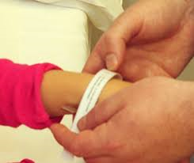
Goal 1: improve the accuracy of patient identification

Slide 3
G OAL 1a: Use of two patient identifiers npsg 01.01.01
G1A – Use at least two patient identifiers when providing care, treatment or services
Patient Name
Date of Birth

Slide 4
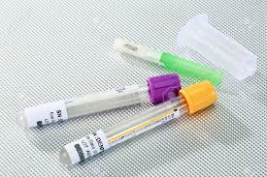
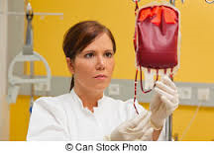
G1b: Eliminating Transfusion errors NPSG .1.03.01
G1B: Improve the Accuracy of Patient Identification
Before initiating a blood or blood component transfusion:
Match the blood or blood component to the order.
Match the patient to the blood or blood component.
Always use the two-person varication process.

Slide 5
Goal 2: Improve the effectiveness of communication among caregivers
Develop written procedures.
Implement the procedures for managing results.
Evaluation the timeliness of reporting results.

Slide 6
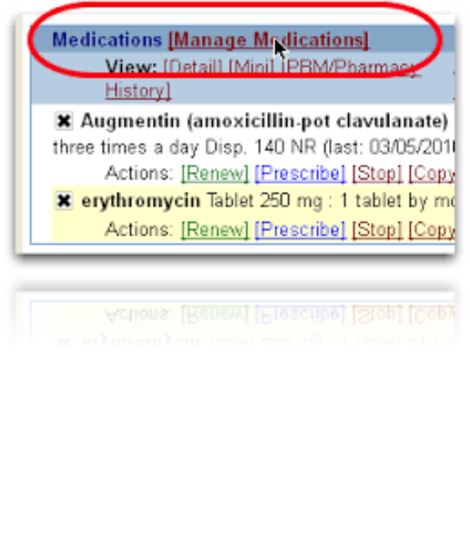
Goal 3: Improve the safety of using medications

Slide 7
Goal 3: Improve the Safety of Using Medications:

Slide 8
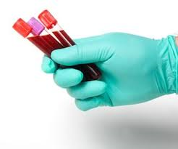
Goal 3D: Label all medications, MEDICATION CONTAINERS OR OTHER SOLUTIONS ON AND OFF THE STERILE FIELD.
Label all medications, medication containers (for example syringes, medicine cups, basins), or other solution on and off of the sterile field. (NPSG 03.04.01)
What is wrong with this picture

Slide 9
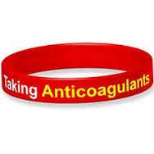
GOAL 3E: REDUCE THE LIKELIHOOD OF PATIENT HARM ASSOCIATED WITH THE USE OF ANTICOAGULATION THERAPY

Slide 10
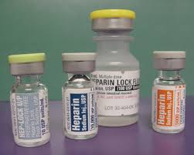
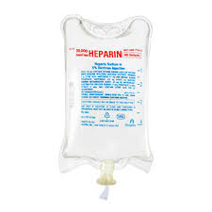
Heparin doses
Brown Cap – 10,000 units
Orange Cap – 5000 units
Blue Cap – Heparin Flush
Intravenous – Lab Scale, Lab

Slide 11
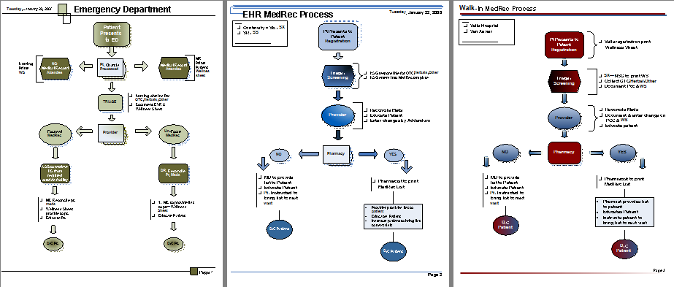
Goal 3f: Medication reconciliation
A process for comparing the patient’s current medication(s)

Slide 12
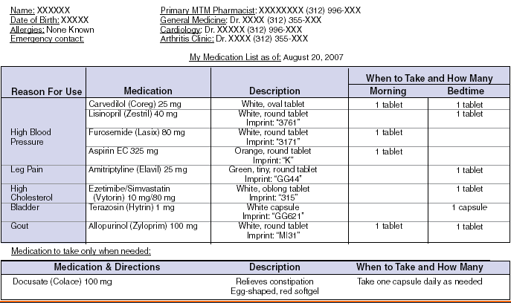
A complete list of the patient’s medications is communicated and provided to the patient on discharge from the facility

Slide 13
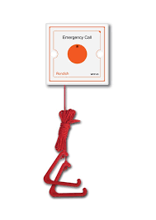
Goal 6: Reduce harm associated with clinical alarms

Slide 14
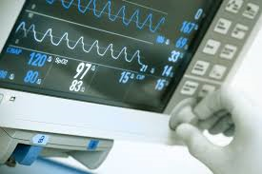
G6A: Improve the safety of Clinical Alarm systems
Leaders establish alarm system safety as a hospital priority.
Identify the most important alarms signals to manage.
Establish policies and procedures.
Educate staff.

Slide 15
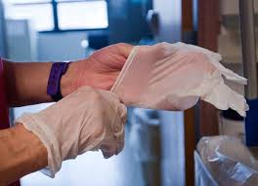
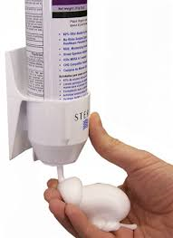
Goal 7: Reduce the risk of health care –associated Infections

Slide 16
Goal 7A: Comply with WHO or CDC hand hygiene guidelines (NPSG 07.01.01)

Slide 17
Goal 7C: Reduce the risk of Health Care Associated Infections.
MDROs (NPSG 07.03.01)
Central venous catheters (NPSG 07.04.01)
Surgical site infections (NPSG 07.05.01)

Slide 18
NPSG 07.03.01
Goal 7: Implement evidence based practices to prevent HAI infections due to MDROs.
Risk assessment
Educate staff
Educate patients
Surveillance
Measure and monitor
Report data
Implement p/p
ID process in lab for alerts on new Dx
Implement alert system with transfers

Slide 19
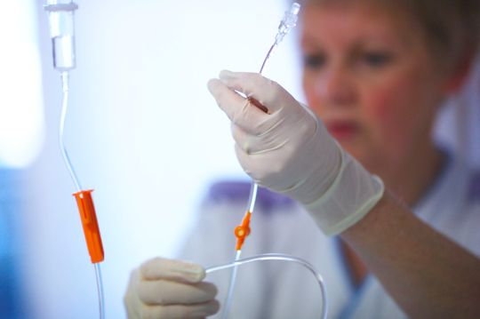
NPSG 07.04.01
Implement evidence based practice to prevent central line-associated bloodstream infections.
Educate
P/P
Implement process
Standardize supplies
Standardize protocols
Evaluate and report

Slide 20
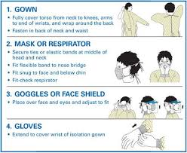
NPSG 07.05.01
Implement evidence based practices for preventing surgical site infections.
Educate staff and patients
Implement p/p
Surveillance
Report outcomes
Administer appropriate antimicrobial agents
Safe hair removal

Slide 21
7F: Preventing Catheter-associate urinary tract infections
This NPSG is not applicable to pediatric populations. Research resulting in evidence-based practices was conducted with adults, and there is no consensus that these practices apply to children.

Slide 22
Goal 15: the organization identifies safety risks inherent in its patient population.
The organization identifies patients at risk for suicide
TONHC Emergency Department – screens and has protocol for patients that are at risk.

Slide 23
IDENTIFY INDIVIDUALS AT RISK FOR SUICIDE NPSG.15.01.01

Slide 24
up.01.01.01
Universal protocol for preventing wrong site, wrong procedure, and wrong person surgery.
Conducting a pre-procedure verification process
Identify items that need to be made available
Label diagnostic and radiology test results, eg. Radiology images, pathology and biopsy reports
Any required blood products, implants, devices and/or special equipment for the procedure, even code carts.

Slide 25
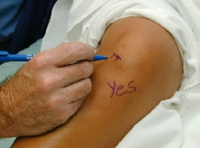
Up.01.02.01
Marking the Procedure Site
Identify those procedures that require marking of incision or insertion site
Mark before the procedure is performed if possible with patient involved
Mark by a LIP
Method for marking is consistent throughout the hospital
Written alternative is in place when patent refuses site marking or when anatomically impossible

Slide 26
Up.01.03.01
A time-out is performed before the procedure.
Conducted immediately before starting the invasive procedure or making the incision
Has the following characteristics
Standardized as defined by the hospital
Initiated by the designated member of the team
Involves immediate members of the procedure team
During the time-out, team members agree with correct patient, correct site and the procedure to be done
Documentation of the completion of the time-out

Slide 27
THANK YOU
Shared Folder:
\\tucsel-vm-fsg\groupdata\Quality Management

